Slide 1

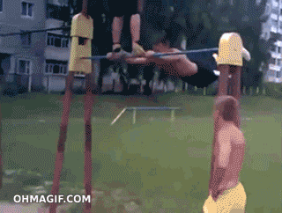

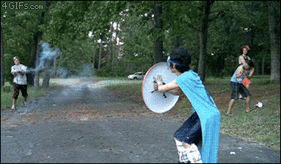
ENERGY

Slide 2

WHAT IS ENERGY?
Energy is the ability to do work (make a change happen).
WORK = done when an object is moved or forced to change shape.

Slide 3
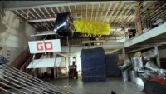
https://youtu.be/qybUFnY7Y8w

Slide 4
What examples of energy did you see?
What would the video clip be like if there was NO energy?

Slide 5

UNITS OF ENERGY
Joule - J
Kilojoule - kJ
Megajoule - MJ
1kJ = 1000J
1MJ = 1000,000J

Slide 6
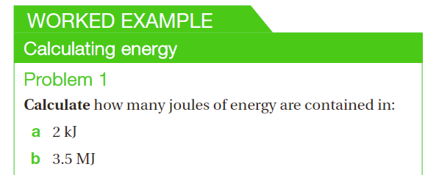
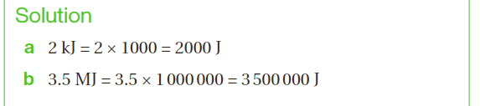

Slide 7
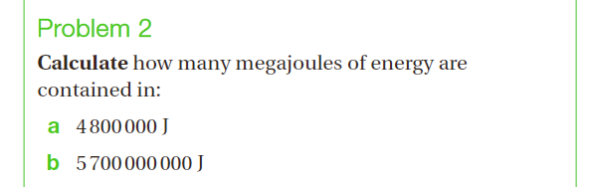
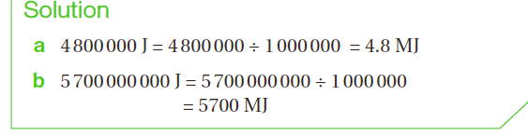

Slide 8
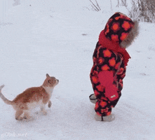
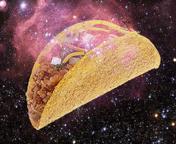
TWO GROUPS OF ENERGY
KINETIC – Energy of motion
POTENTIAL – Stored energy

Slide 9
HEAT
SOUND
KINETIC ENERGY
MOTION
LIGHT
ELECTRICAL

Slide 10
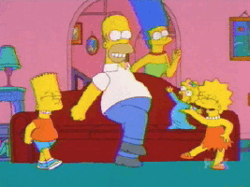
KINETIC ENERGY
The energy of movement.
Anything that moves has KE.
More velocity = more KE
More mass = more KE

Slide 11
KINETIC ENERGY
The faster an object moves, the more KE it has.
SPEED (km/hr) | Risk of death or injury compared with travelling at 60km/hr
65 | Double
70 | 4 times
75 | 11 times
80 | 32 times

Slide 12
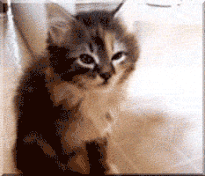
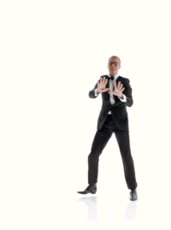
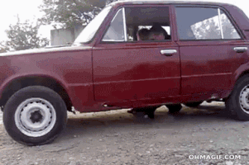
MOTION

Slide 13
HEAT
SOUND
KINETIC ENERGY
MOTION
LIGHT
ELECTRICAL

Slide 14
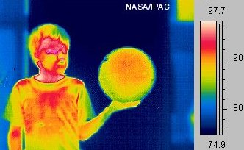
HEAT ENERGY
Particles that make up matter are always moving.
Heat = the total KE possessed by particles in a substance.
Low KE = low temp
High KE = high temp

Slide 15
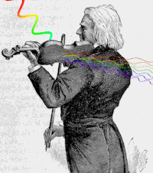
SOUND ENERGY
The energy that travels as vibrating waves in the air.

Slide 16

LIGHT ENERGY
Form of visible
energy that
travels as a wave.

Slide 17
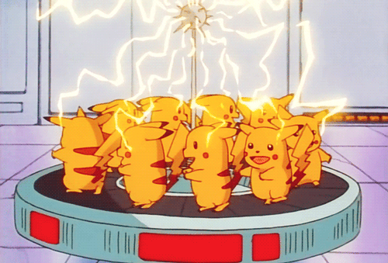
ELECTRICAL ENERGY
Energy possessed by moving electrons (tiny particles that spin around atoms).

Slide 18
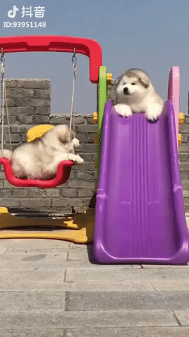
POTENTIAL ENERGY
STORED ENERGY
Energy possessed by an object because of its position or structure.
It gives objects the ‘potential’ to make things happen.

Slide 19
GRAVITATIONAL
CHEMICAL
POTENTIAL ENERGY
ELASTIC
NUCLEAR

Slide 20
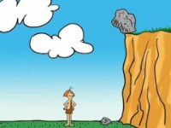
https://youtu.be/ASZv3tIK56k

Slide 21
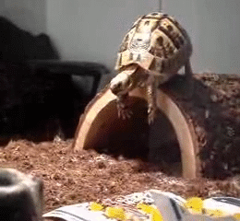
GRAVITATIONAL PE
Energy stored in an object when it is above the ground.
More height = more GPE
More mass = more GPE

Slide 22
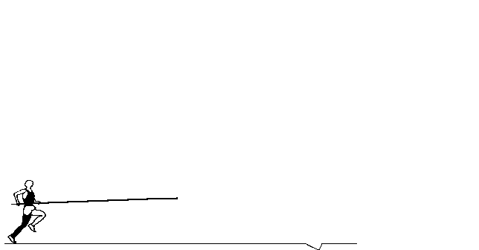

Slide 23
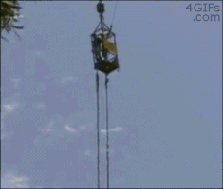
ELASTIC PE
Energy stored in a stretched or compressed object.
Eg; stretched rubber bands, springs.

Slide 24
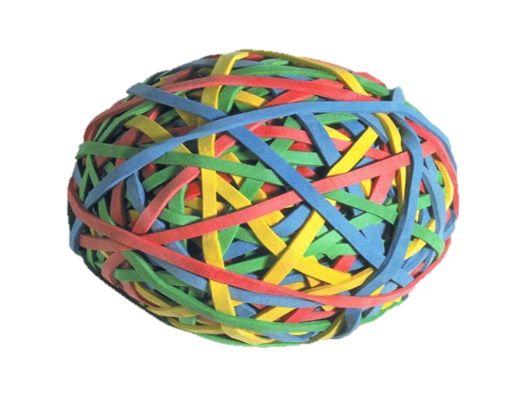
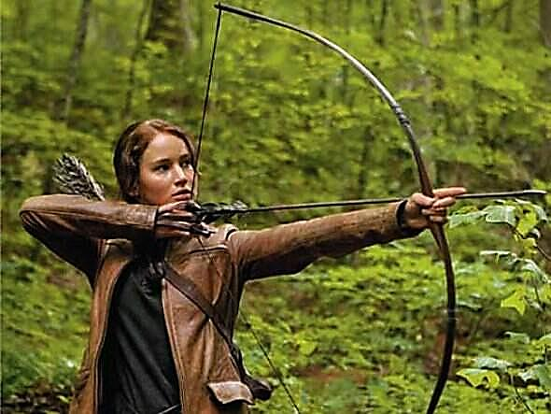
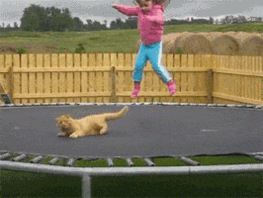
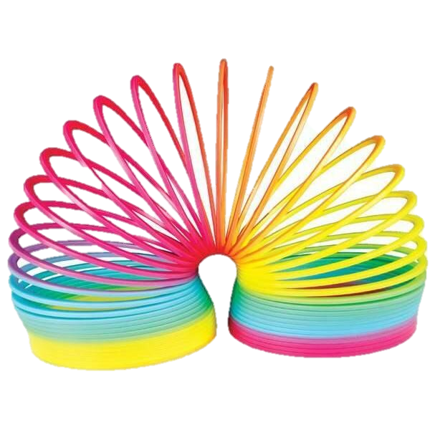

Slide 25

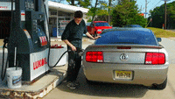
CHEMICAL ENERGY
Energy stored within a substance.
Eg; Fuel, food & batteries

Slide 26

NUCLEAR ENERGY
Energy stored inside an atom.
Nuclear energy is released in a:
Nuclear power plant
Nuclear bomb explosion
Inside the Sun

Slide 27
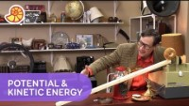
https://youtu.be/quxEz2qxo9s

Slide 28
Practical activity
ENERGY STATIONS
STATION | KE or PE or BOTH? | Types of energy

Slide 29
Rube Goldberg machines
https://www.youtube.com/watch?v=nORRgU8sGdE ~4min
https://www.youtube.com/watch?v=0lz8_aaKNXA
https://www.youtube.com/watch?v=OHwDf8njVfo

Slide 30
DESIGN A RUBE GOLDBERG MACHINE
MATERIALS
Plastic/paper cups
Aluminium foil
Toy cars
Plastic pipe
String
Rubber bands
Paper clips
Straws
Pegs
Balloons
Plastic spoons
Plastic container
Scissors
Tape
Plasticine
Hair dryer
Popsicle sticks
Textbooks
Funnels
Foil trays
Ping pong balls
Golf balls
RULES
It must operate for at least 15 seconds
Must have AT LEAST 3 types of energy
Task = to get 1 marble into a cup
YOU CAN ALSO USE OTHER THINGS FOUND IN THE CLASSROOM & BRING THINGS FROM HOME

Slide 31
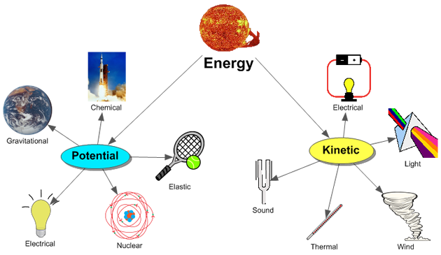

Slide 32
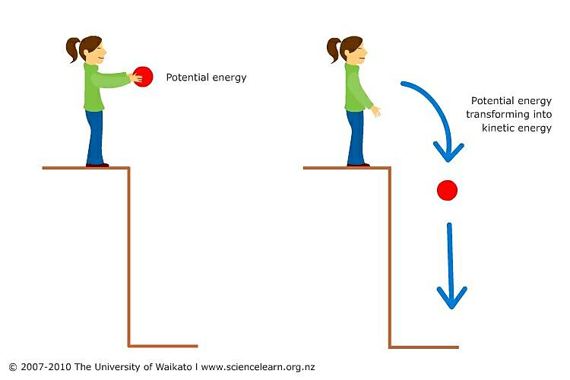

Slide 33
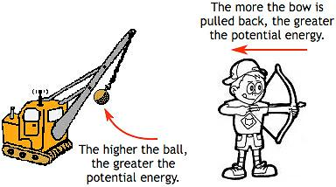

Slide 34
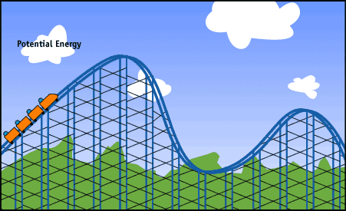

Slide 35
Review time!!
1. Name the unit used to measure energy. (Hint = the symbol is J )
2. List five different forms of energy.

Slide 36
a kinetic energy
b sound energy
c elastic potential energy
d gravitational potential energy
e light energy
i in vibrating air particles
ii in a stretched or squashed spring
iii in objects positioned above the ground
iv released from a lamp
v in a moving object
3 Recall what you know about energy by matching the following types with their descriptions.

Slide 37
4. Explain why sound energy could be considered a type of kinetic energy.
5. Petrol, kerosene and oil are all types of fuel. Clarify which type of energy these fuels possess.
6. Describe situations in which kinetic energy could cause damage.

Slide 38
7. Your body needs a source of energy. Use this diagram to help you to list four different ways that the chemical energy in food can be used by your body.

Slide 39
8. Identify the key type of energy possessed by a:
a seatbelt buckle that has been in the sun all day
b shopping trolley rolling across the floor
c marshmallow
d lawnmower filled up with petrol
e bird resting in its nest on a tree branch.

Slide 40
9. When Ben dances, he moves his arms and legs, he sings and he gets hot.
List three types of energy that are present when Ben dances.

Slide 41
10. The following objects have potential energy. Classify each one as an example of:
Gravitational potential energy (GPE), chemical potential energy (CPE) or elastic potential energy (EPE).
a A piece of chocolate cake
b A stretched spring
c A glass of cola
d An empty coffee mug on a table
e A teaspoon of sugar
f A cardboard box
g A 9-volt battery
h A painter at the top of a ladder
i A banana
j A squashed tennis ball

Slide 42
11. For each pair of objects shown in the images below:
i identify which
(A or B) has more energy
ii justify your response.

Slide 43
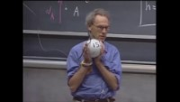
https://youtu.be/PWNs7i4rEWA

Slide 44
LAW OF CONSERVATION OF ENERGY
Energy cannot be created or destroyed.
This means that:
It is transferred from one object to another or transformed into another form of energy.
Energy might be passed on or wasted, but it is never ‘lost’.
→ If one object wastes energy, then it is always gained by another object, usually as heat.

Slide 45
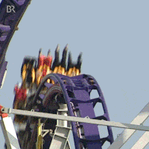
WHAT HAPPENS TO THE ENERGY OF FALLING OBJECTS?
A falling object loses GPE and gains KE. This is an example of the law of conservation of energy.
gravitational potential energy (GPE) lost equals
kinetic energy (KE) gained
If the rollercoaster has 15 000 J of GPE at the top of the slope, how much KE will it have gained when it reaches the bottom?
15 000 J, assuming that no
air resistance and friction.
Notes:
Photo credit: © 2006 Jupiterimages Corporation
The Pepsi Max Big One rollercoaster ride at Blackpool Pleasure Beach.

Slide 46
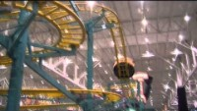
https://youtu.be/Ehx1P4adv6I

Slide 47
GAME TIME!
THUMBS UP = KINETIC ENERGY
THUMBS DOWN = POTENTIAL ENERGY

Slide 48

ENERGY TRANSFER
The flow of energy from one object to another object.
Eg; Flow of kinetic energy from a bat to a ball that it hits.

Slide 49
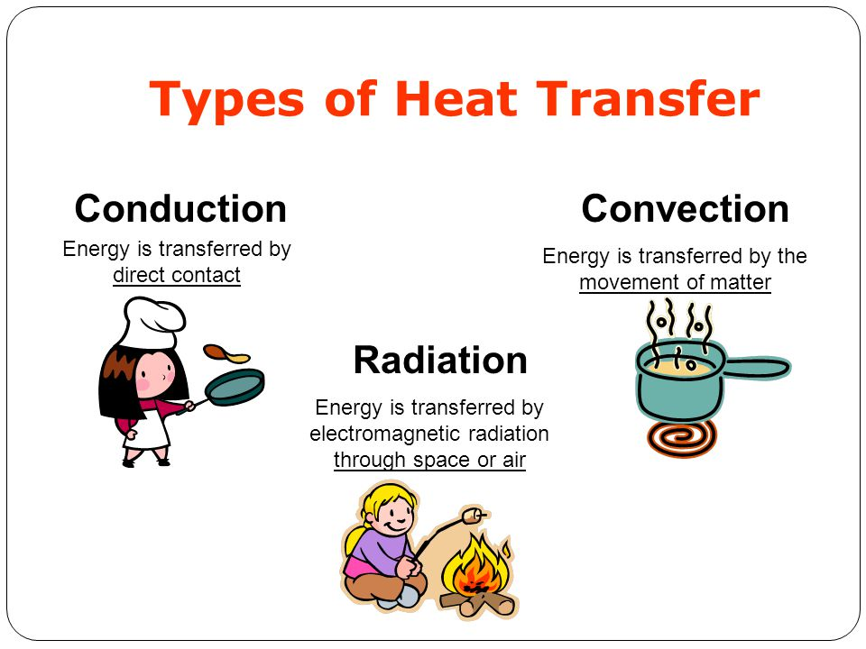
HEAT TRANSFER as an example of energy transfer

Slide 50
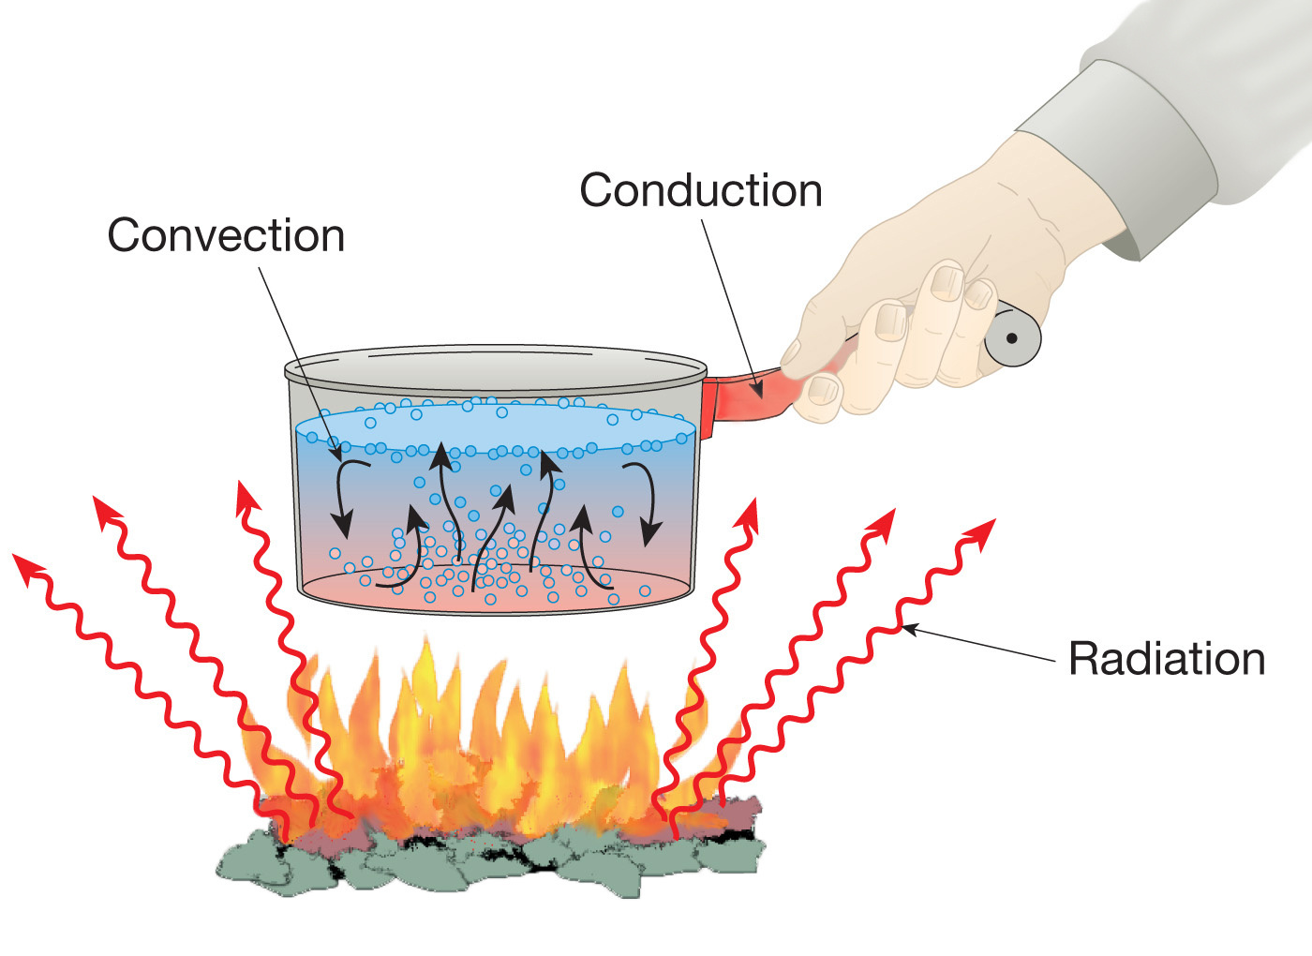
HEAT TRANSFER as an example of energy transfer

Slide 51
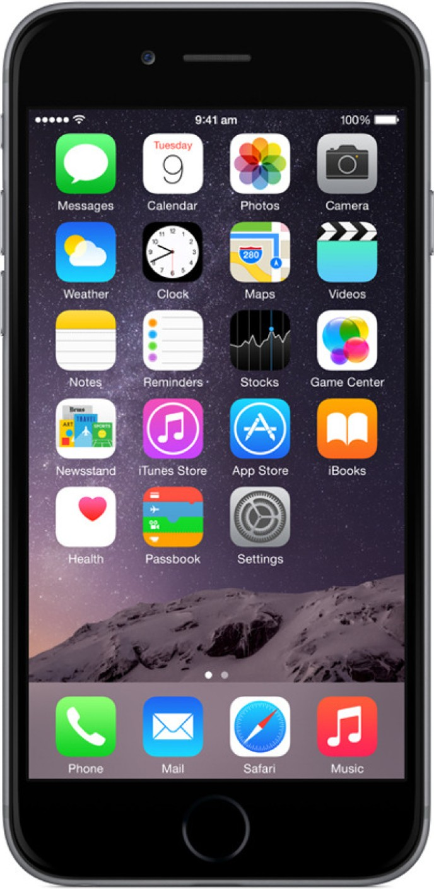
ENERGY TRANSFORMATION
Changing of one TYPE of energy into another type of energy.
Eg; Changing of electrical energy used in iPhone into sound, light and heat energy.

Slide 52
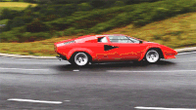
What are the main energy changes in a car engine? (Don’t forget the wasted energy)
kinetic
chemical
sound
heat

Slide 53

An energy flow diagram shows the input and output energies for a device.
This includes all the USEFUL AND WASTED forms of energy.
For example, in a television:
light
electrical
sound
heat

Slide 54
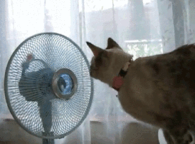
Many household objects are designed to transform energy from one form into another useful form.
What energy transformation is an electric fan designed to carry out?
electrical
energy
Kinetic (motion), sound & heat
Notes:
Photo credit: © 2006 Jupiterimages Corporation
Vintage-style electric fan.

Slide 55
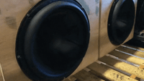
What energy transformation are these speakers designed to carry out?
electrical
energy
Sound & heat
Notes:
Photo credit: © 2006 Jupiterimages Corporation
Pair of computer speakers.

Slide 56
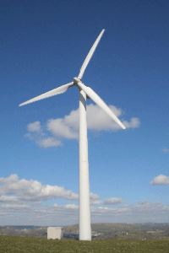
What energy transformation are wind turbines in a wind farm designed to carry out?
kinetic
energy
Kinetic (motion), electrical & heat
Notes:
Photo credit: © 2006 Jupiterimages Corporation
Wind turbines in California.

Slide 58
COMPLETE THIS NOW!
In your science notebook draw energy transformation diagrams for each of the following:
Egg dropped from a balcony
Fuel rocket launched into the air
Person cycling
Fireworks exploding
Toaster pushed down to cook toast
Battery operated torch switch on
Solar powered fan switched on

Slide 59
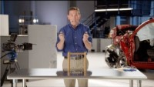
https://youtu.be/69T9qnIIrJA

Slide 60
NAME OF STATION | STARTING ENERGY | FINISHING ENERGY

Slide 61
REVIEW TIME!!
1. Use an example to explain what is meant by the term energy transformation.
2. Describe the energy transformation(s) that take place when you cook popcorn in a microwave oven.

Slide 62
3. Use your knowledge of energy transformations to match the situations a – d below with the appropriate energy transformations i–iv.
a You ride a bike.
b A wind-up toy car travels across the floor.
c A boy swims in a pool.
d Wood burns in a fire.
i chemical energy → kinetic energy + sound energy + heat energy
ii chemical energy → heat energy + light energy + sound energy
iii elastic potential energy ◊ kinetic energy + sound energy
iv chemical energy → kinetic energy + sound energy + heat energy

Slide 63
4. Construct a flow diagram to show the energy changes that happen when you:
a ring a doorbell
b light a match
c fall over

Slide 64

https://youtu.be/St2q6oGO6xo

Slide 65
MUSIC ON = Walk, don’t talk MUSIC OFF = Share with the person closest to you
What does energy transformation mean?
What has more KE – A car travelling 60km/hr or 80km/hr?
What type of energy does a magpie sitting in a tree have?
Name 3 types of kinetic energy
Give one example of a type of potential energy you have used today.

Slide 66
GRAVITATIONAL Potential Energy CALCULATIONS
E_{GP} = m x g x h
E_{GP} = Gravitational potential energy
m = MASS (kg)
h = HEIGHT (metres)
g = acceleration due to gravity
(9.8m/s for Earth)

Slide 67
Give these a go!
Q 1) Calculate the GPE of a 30kg child when:
They are on top of a 2m slide
They are sitting on the ground

Slide 68
Q 2) Calculate the GPE of a 0.45kg bird when:
It is flying 18m above the ground.
It is sitting on a branch 7m above the ground:

Slide 69
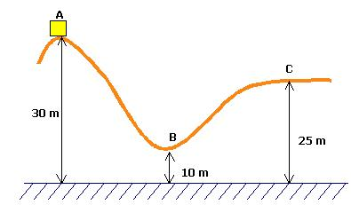
The rollercoaster cart is 735kg

Slide 70
CHALLENGE #1
Q 3) Calculate the mass of a car being air-lifted 10m above the ground with GPE of 25,000J.

Slide 71
CHALLENGE #2
Q 4) How high above the ground is a 1200kg cart sitting on top of a rollercoaster track if it has 75,500J GPE?

Slide 72
CHALLENGE 3:
A 0.5kg ball is dropped from a height of 3m.
Calculate its:
GPE when it is about to be released.
Kinetic energy when it has fallen halfway.
KE when it hits the ground.

Slide 73
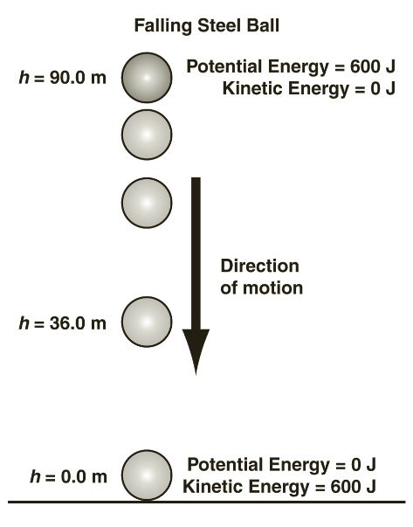
E_{p} = E_{k}

Slide 74
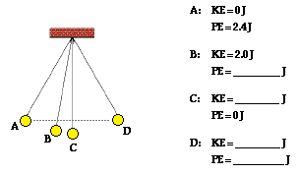

Slide 75
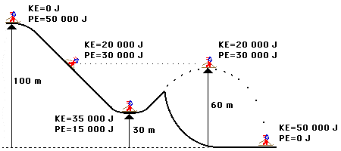

Slide 76
MUSIC ON = Walk, don’t talk MUSIC OFF = Share with the person closest to you
What does ‘m’ stand for in the energy formula?
What has more GPE – A cat on a house roof or a cat sitting on the kitchen table (assume mass is the same)?
What does ‘g’ stand for in the formula GPE = mxgxh
What does ‘h’ stand for in the energy formula?
What unit is energy measured in?

Slide 77
KINETIC ENERGY CALCULATIONS
E_{K} = 0.5 x m x v²
E_{K} = KINETIC ENERGY
m = MASS of object (kg)
V = VELOCITY of object (m/s)

Slide 78
GIVE THESE A GO!
Q 1) Calculate the KE of a 1300kg car travelling at:
5m/s
16m/s

Slide 79
Q 2) Calculate the KE of a 5400kg elephant travelling at:
2.5m/s
7m/s

Slide 80
Q 3) Calculate the KE of a 80kg man jogging at:
7m/s
15m/s

Slide 81
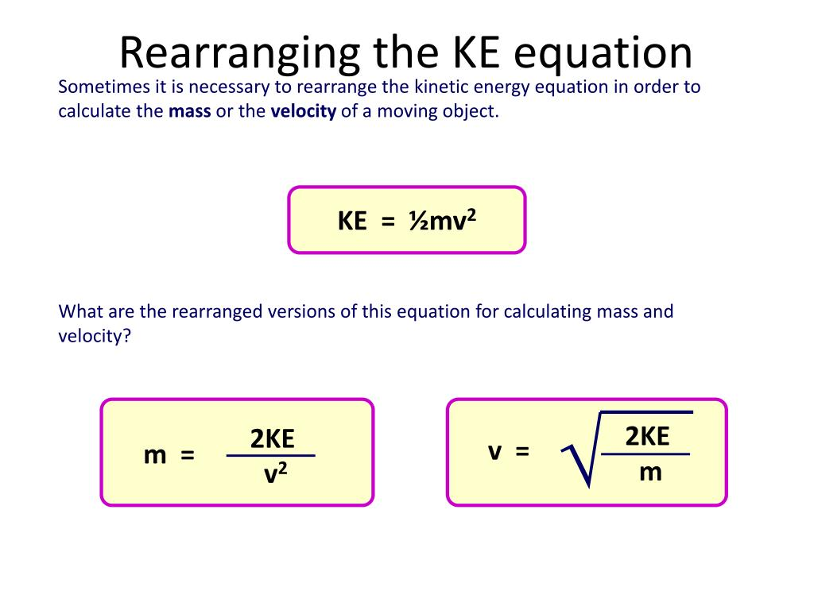

Slide 82
CALCULATE THIS NOW!
In your science work book
Mrs Clauson walked to class at 5m/s, if her mass is 75kg, how much kinetic energy did she have?
Mrs Clauson saw a spider and froze, completely still, her mass is still 75kg, how much kinetic energy did she have?

Slide 83
MUSIC ON = Walk, don’t talk MUSIC OFF = Share with the person closest to you
What does energy transformation mean?
What has more kinetic energy – A car travelling 60km/hr or 80km/hr?
What type of energy does a magpie sitting in a tree have?
Name 3 types of kinetic energy
Give one example of a type of potential energy you have used today.

Slide 84



SIT DOWN, BOOK OUT & THINK ABOUT THIS
Mrs Clauson needs to buy a new car.
The only information she has is: the types of energy the petrol is transformed into.
FINISH THIS SENTENCE: Mrs Clauson should buy CAR ….. because
CAR A
55% kinetic energy
20% heat energy
25% sound energy (engine)
CAR B
85% kinetic energy
10% heat energy
5% sound energy (engine)
CAR C
85% kinetic energy
10% heat energy
5% light energy

Slide 85
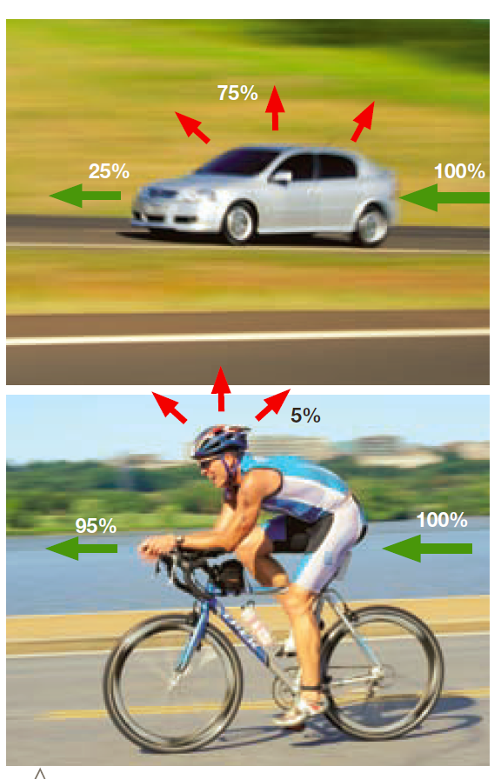
THINK PAIR SHARE
HEAT
KE (MOTION)
1. What do you think ‘energy efficiency’ means?
2. Which of the images is MORE energy efficient? Why?
HEAT
KE (MOTION)

Slide 86
ENERGY EFFICIENCY
A measure of how much input energy is transformed into USEFUL output energy.
There is NEVER 100% efficiency
Energy that does not do ‘useful’ work is called ‘wasted’ energy.
Devices usually waste energy as SOUND and HEAT

Slide 87
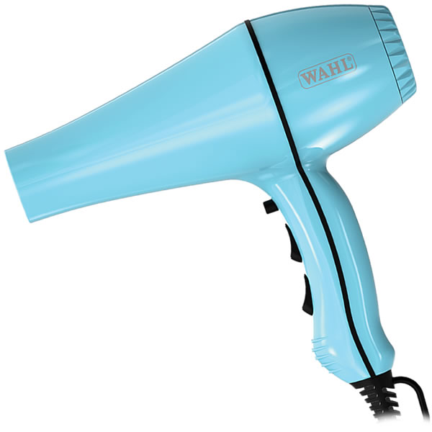
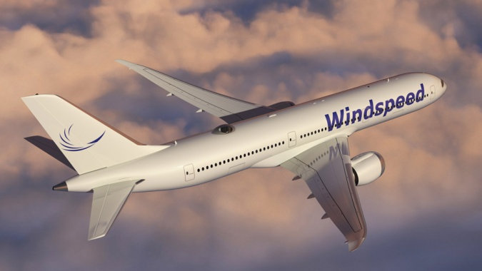


WHICH DEVICES WASTE ENERGY AS SOUND?
If a device makes noise but is not designed to make noise, then energy is being wasted as sound.
Which devices below waste energy as sound?

Slide 88



WHICH DEVICES WASTE ENERGY AS HEAT?
If a device gets warm but it is not designed to get warm, then energy is wasted as heat.
Which devices waste energy as heat ?

Slide 89
HOW IS ENERGY EFFICIENCY CALCULATED?
The energy efficiency of a device can be calculated using this formula:
useful output energy
total input energy
energy efficiency =
X100
Useful energy is measured in joules (J).
Total energy is measured in joules (J).
Energy efficiency can be converted into a percentage by multiplying by 100.

Slide 90

CALCULATE THE EFFICIENCY OF A BULB
This light bulb is supplied with 100 J of electrical energy, which it converts to 45 J of light energy.
How much energy
is wasted?
In what form is the energy wasted?
What is the efficiency
of the bulb?
Wasted energy = Total – Useful
= 100 J – 45 J
= 55 J
55 J
Efficiency = Useful output energy
Total input energy
= 45 J X100
100 J
= 0.45 or 45%
heat
0.45 or 45%

Slide 91

CALCULATE THE EFFICIENCY OF A RADIO
This radio is supplied with 300 J of electrical energy which it converts to 96 J of sound energy.
How much energy
is wasted?
In what form is the energy wasted?
What is the efficiency of the radio?
204 J
Wasted energy = Total – Useful
= 300 J – 96 J
= 204 J
heat
Efficiency = Useful output energy
Total input energy
= 96 J X100
300J
= 0.32 or 32%
0.32 or 32%
Notes:
Teacher notes
This slide could be used as a further example of how to calculate efficiency. Students could be asked to solve the problem before revealing the model answer and working out.

Slide 92
TODAY’S TASK
Work through the energy efficiency exercises in the worksheet provided.

Slide 93
EXIT PASS
In your own words…
Why do YOU think it is useful to know the energy efficiency of a device?

Slide 94

EG: If 1J of GPE was transformed into 0.9J of KE and 0.1J of heat.
Energy efficiency = 0.9/1 x 100 = 90%

Slide 95
Compare these two cranes to decide which is the more efficient.
i Crane A uses 800 J of energy to do 350 J of useful work.
ii Crane B uses 750 J of energy to do 300J of useful work.

Slide 96


Slide 97


Slide 98

YOUR TASK
At approximately 1.17pm on 9 March 2020, while your teacher was at school their house was broken into!
The thieves left a terrible mess and your teacher is finding it difficult to work out what was stolen.
The thief left a clue……they like to steal the 5 MOST energy efficient items.
What 5 items were stolen from your teachers’ home?! Your teacher needs your help!!
The WA police only had time to investigate one device. You must complete the rest.

